Slide 1
Python Programming
CONTROL STRUCTURES

Slide 2
Decision Making Statements
Python if...else
Python for Loop
Python while Loop
Python break and continue
Python pass

Slide 3
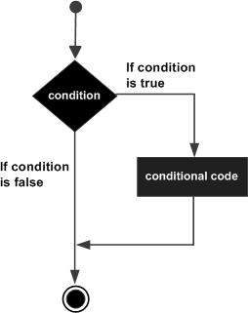
Python if Statements
if statement contains a logical expression using which data is compared and a decision is made based on the result of the comparison.
Syntax
if expression:
statement

Slide 4
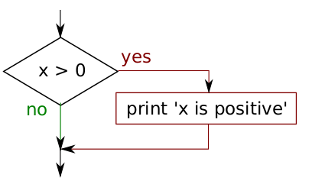
Example: Python if Statement
if x > 0 :
print( 'x is positive')
Note:
The Boolean expression after the if statement is called the condition. We end the if statement with a colon character (:) and the line(s) after the if statement are indented.

Slide 5
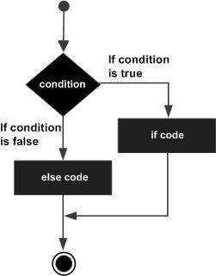
Python if...else
An else statement contains the block of code that executes if the conditional expression in the if statement resolves to 0 or a FALSE value.
Syntax
if expression:
statement(s)
else:
statement(s)

Slide 6
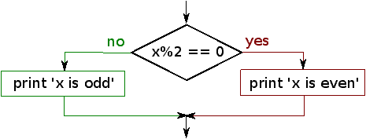
Example of if...else
if x%2 == 0 :
print( 'x is even')
else :
print ('x is odd')
Note:
If the remainder when x is divided by 2 is 0, then we know that x is even, and the program displays a message to that effect. If the condition is false, the second set of statements is executed.

Slide 7
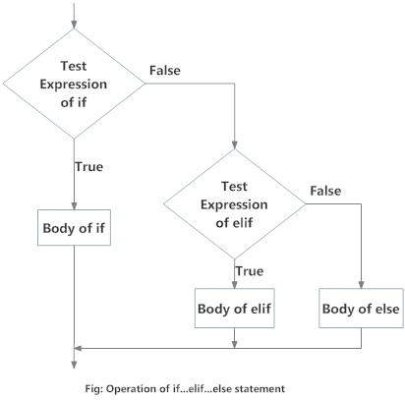
Python if...elif...else Statemen (Chained Conditionals)
Sometimes there are more than two possibilities and we need more than two branches. One way to express a computation like that is a chained conditional
Syntax:
If statement:
Body
elif statement:
Body
else:
Body

Slide 8
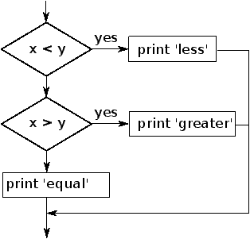
Example of if...elif...else
if x < y:
print( 'x is less than y')
elif x > y:
print( 'x is greater than y')
else:
print( 'x and y are equal')

Slide 9
Example of if...elif...else
Code:
if choice == 'a':
print ('Bad guess')
elif choice == 'b':
print ('Good guess')
elif choice == 'c':
print('Close, but not correct')

Slide 10
Python Nested if statements
Syntax
if expression1:
statement(s)
if expression2:
statement(s)
elif expression3:
statement(s)
else
statement(s)
elif expression4:
statement(s)
else:
statement(s)
In a nested if construct, you can have an if...elif...else construct inside another if...elif...else construct.

Slide 11
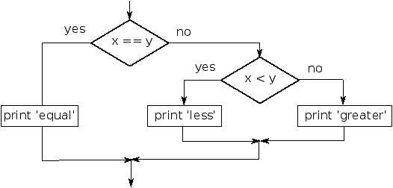
Python Nested if Example
if x == y:
print ('x and y are equal')
else:
if x < y:
print ('x is less than y')
else:
print ('x is greater than y')

Slide 12
Python Nested if Example
Code:
num = int(input("enter number"))
if num%2 == 0:
if num%3 == 0:
print ("Divisible by 3 and 2")
else:
print ("divisible by 2 not divisible by 3")
else:
if num%3 == 0:
print ("divisible by 3 not divisible by 2")
else:
print ("not Divisible by 2 not divisible by 3")

Slide 13
Check out these examples
Check if a Number is Positive, Negative or 0
Check if a Number is Odd or Even

Slide 14
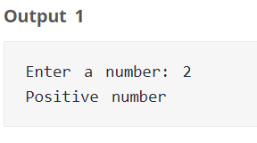
Check if a Number is Positive, Negative or 0
Code:
>>> num = float(input("Enter a number: "))
>>> if num > 0:
print("Positive number")
elif num == 0:
print("Zero")
else:
print("Negative number")
Code:
>>> num = float(input("Enter a number: "))
>>> if num >= 0:
if num == 0:
print("Zero")
else:
print("Positive number")
else:
print("Negative number")

Slide 15
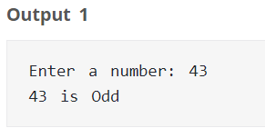
Check if a Number is Odd or Even
Code:
num = int(input("Enter a number: "))
if (num % 2) == 0:
print("{0} is Even".format(num))
else:
print("{0} is Odd".format(num)

Slide 16
Python for Loop
It has the ability to iterate over the items of any sequence, such as a list or a string.
Syntax
for iterating_var in sequence:
statements(s)

Slide 17
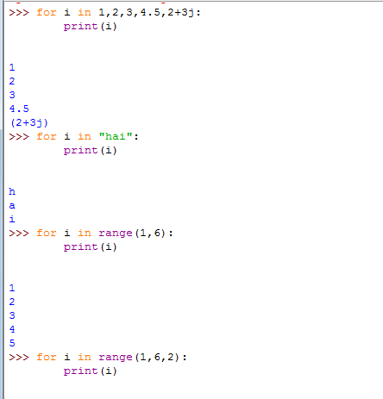
Python For Examples
Code:
>>> for letter in 'Python':
print ('Current Letter :', letter)
>>> fruits = ['banana', 'apple', 'mango’]
>>> for fruit in fruits:
print ('Current fruit :', fruit)
>>> print ("Good bye!")

Slide 18
The range() function
It is used to iterate over the specific number of times within the given range in steps/intervals.
Syntax
range(lowerlimit, upperlimit, increment/decrement)

Slide 19
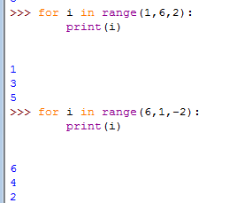
Examples of range()

Slide 20
Iterating by Sequence Index
An alternative way of iterating through each item is by index offset into the sequence itself.
Example
>>> fruits = ['banana', 'apple', 'mango’]
>>> for index in range(len(fruits)):
print( 'Current fruit :', fruits[index])
>>> print("Good bye!")

Slide 21
Nested for Loops
Loops defined within another Loop is called Nested Loop.
Syntax for nested for loop:
for iterating_var in sequence: for iterating_var in sequence: statements(s) statements(s)
Example
for i in range(1,6):
for j in range (1,i+1):
print( i)
print ()

Slide 22
Using else Statement with Loops
Example
for num in range(10,20): #to iterate between 10 to 20
for i in range(2,num): #to iterate on the factors of the number
if num%i == 0: #to determine the first factor
j=num/i #to calculate the second factor
print ('%d equals %d * %d' % (num,i,j))
break #to move to the next number, the #first FOR
else: # else part of the loop
print( num, 'is a prime number')

Slide 23
Check out these examples
Check Prime Number
Find the Factorial of a Number

Slide 24
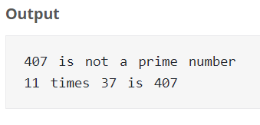
Check Prime Number
Code:
num = 407
if num > 1:
for i in range(2,num):
if (num % i) == 0:
print(num,"is not a prime number")
print(i,"times",num//i,"is",num)
break
else:
print(num,"is a prime number")
else:
print(num,"is not a prime number")

Slide 25
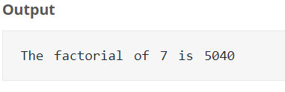
Find the Factorial of a Number
Code:
num = 7
factorial = 1
if num < 0:
print("Sorry, factorial does not exist for negative numbers")
elif num == 0:
print("The factorial of 0 is 1")
else:
for i in range(1,num + 1):
factorial = factorial*i
print("The factorial of",num,"is",factorial)

Slide 26
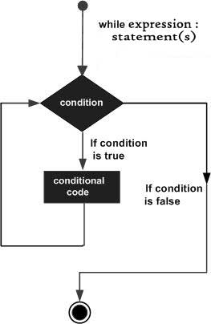
While Loop Statements
Repeats a statement or group of statements while the given condition is TRUE.
Syntax:
while (condition):
statements

Slide 27
Example: Python while Loop
Code:
count = 0
while (count < 9):
print ('The count is:', count)
count = count + 1
print ("Good bye!")
Output:
The count is: 0
The count is: 1
The count is: 2
The count is: 3
The count is: 4
The count is: 5
The count is: 6
The count is: 7
The count is: 8
Good bye!

Slide 28
Using else Statement with Loops
1. If the else statement is used with a for loop, the else statement is executed when the loop has exhausted iterating the list.
2. If the else statement is used with a while loop, the else statement is executed when the condition becomes false.
Output:
0 is less than 5
1 is less than 5
2 is less than 5
3 is less than 5
4 is less than 5
5 is not less than 5
Code:
count = 0
while count < 5:
print(count, " is less than 5")
count = count + 1
else:
print(count, " is not less than 5")

Slide 29
Check out these examples
Print the Fibonacci sequence
Check Armstrong Number
Find Armstrong Number in an Interval

Slide 30
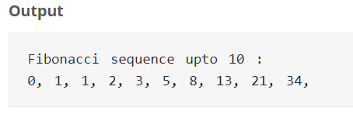
Print the Fibonacci sequence
Code:
nterms = 10
n1 = 0
n2 = 1
count = 0
if nterms <= 0:
print("Please enter a positive integer")
elif nterms == 1:
print("Fibonacci sequence upto",nterms,":")
print(n1)
else:
print("Fibonacci sequence upto",nterms,":")
while count < nterms:
print(n1,end=' , ')
nth = n1 + n2
n1 = n2
n2 = nth
count += 1

Slide 31
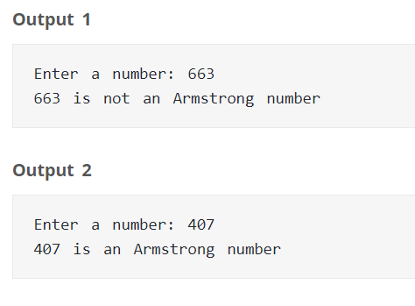
Check Armstrong Number
Code:
sum = 0
temp = num
while temp > 0:
digit = temp % 10
sum += digit ** 3
temp //= 10
if num == sum:
print(num,"is an Armstrong number")
else:
print(num,"is not an Armstrong number")

Slide 32
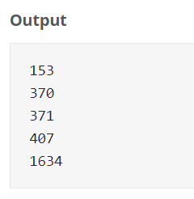
Find Armstrong Number in an Interval
Code:
lower = 100
upper = 2000
for num in range(lower, upper + 1):
order = len(str(num))
sum = 0
temp = num
while temp > 0:
digit = temp % 10
sum += digit ** order
temp //= 10
if num == sum:
print(num)

Slide 33
Loop Control Statements
Python break statement
Python continue statement
Python pass statement

Slide 34
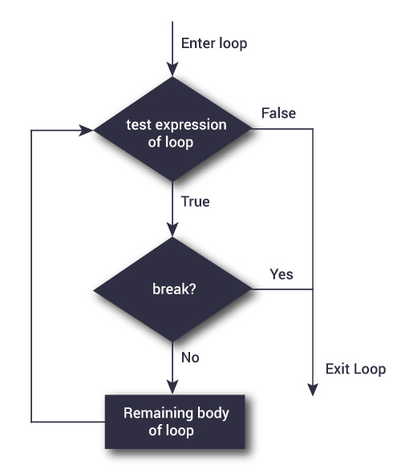
Python break statement
The break statement terminates the loop containing it. Control of the program flows to the statement immediately after the body of the loop.
If break statement is inside a nested loop (loop inside another loop), break will terminate the innermost loop.
Syntax: break

Slide 35
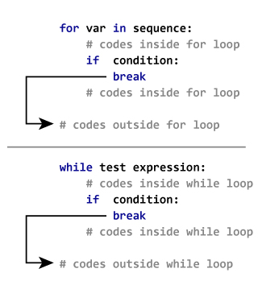
Cont.….
The working of break statement in for loop and while loop is shown below.

Slide 36
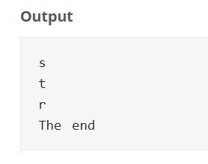
Example: Python break
Code:
for val in "string":
if val == "i":
break
print(val)
print("The end")

Slide 37
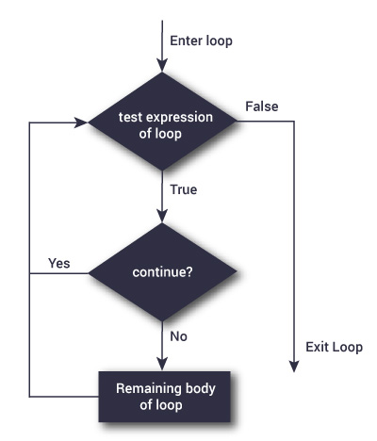
Python continue statement
The continue statement is used to skip the rest of the code inside a loop for the current iteration only.
Loop does not terminate but continues on with the next iteration.
Syntax: continue

Slide 38
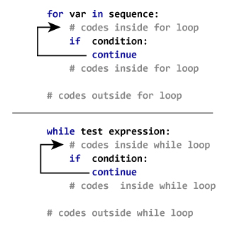
The working of continue statement in for and while loop is shown below.

Slide 39
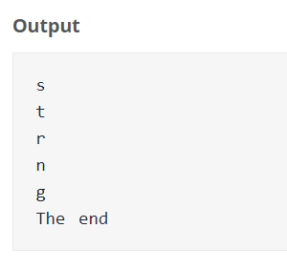
Example: Python continue
Code:
for val in "string":
if val == "i":
continue
print(val)
print("The end")

Slide 40
Python pass statement
It is used when a statement is required syntactically but you do not want any command or code to execute.
The pass statement is a null operation; nothing happens when it executes.
Another place pass can be used is as a place-holder for a function or conditional body when you are working on new code, allowing you to keep thinking at a more abstract level.
>>> def initlog(*args):
... pass # Remember to implement this!
...

Slide 41
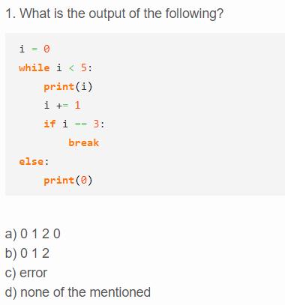
Take Quiz

Slide 42

Answer

Slide 43
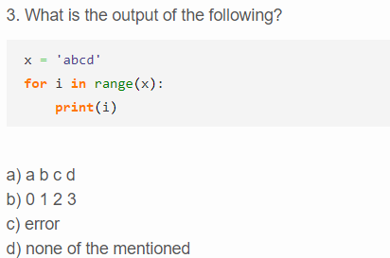
Take Quiz

Slide 44
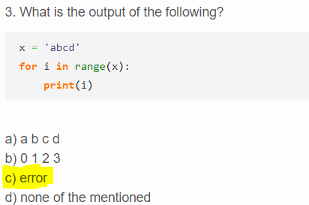
Answer

Slide 45
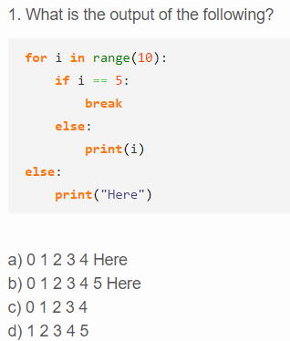
Take Quiz

